Slide 1

Business Intelligence Intro to Python
Barcelona, 21/05/2020
Strictly Confidential

Slide 2
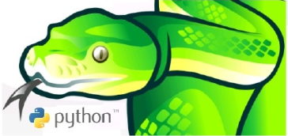
What is python
Python is friendly and easy to learn and a powerful programming language.
Python is programming language:
Interpreted
Dynamic
OO (leitmotiv: Everything is an object)
General purposes
Multiplatform

Slide 3
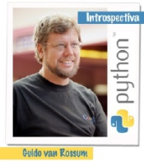
PYTHON HISTORY
Python was first released in 1991, initially developed by Guido van Rossum. Python was inspired by ABC and Haskell programming languages.
Python is developed under an OSI-approved open source license, making it freely usable and distributable, even for commercial use. Python's license is administered by the Python Software Foundation
Its name was ispired by the BBC series: The Monty Python.

Slide 4
python
Python is a high-level, general-purpose, cross-platform, interpreted language.
It can be used for many types of software development. The purpose of the Python language design emphasizes programmer productivity and code readability.
Today Python is maintained by a large group of volunteers around the world. Python is an open source software.
Frequently compared with languages ​​like: TCL, Perl, Scheme, Java and Ruby.

Slide 5
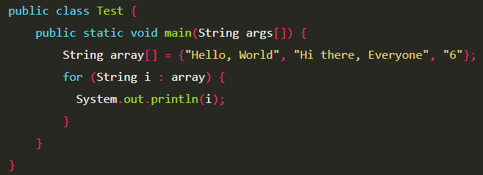
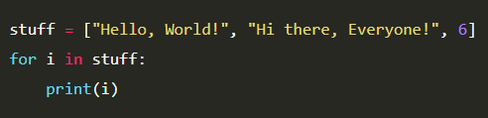
Python features
Python is a very expressive language, that is, Python programs are very compact.
Python syntax is very elegant and allows writing programs that are easy to read.
Python offers an interactive environment for testing and debugging.
The Python runtime environment detects many of the programming errors that are under the control of compilers and provides rich information to detect and correct them.
Python can be used as a procedural language or as an object-oriented language.
It has a rich set of data structures that can be easily manipulated.

Slide 6
Python features
It is a language interpreted with dynamic typing, strongly typed, you can change the type of any variable but you can’t make operations between objects of different types straightforward.
An interpreted language is one that is run using an intermediate program called an interpreter, rather than compiling the code into machine language that can be directly understood and executed by a computer just as compiled languages ​​are.
Example of Interpreted languages: Perl, Ruby, PHP, TCL, Bash.

Slide 7
Python features
The advantage of compiled languages ​​is that they run faster. However, interpreted languages ​​are more flexible and more portable.
However, Python has many of the characteristics of compiled languages, so it could be said that it is semi-interpreted.
In Python, as in Java and many other languages, the source code is translated into a pseudo intermediate machine code called bytecode the first time it is executed, generating .pyc or .pyo files (optimized bytecode), which are the ones that will be executed in successive occasions

Slide 8
Specific Python Features
Dynamic Typing, it is not necessary to declare a data type that contains a variable, it is automatically assigned when giving a value to the variable.
Strongly Typed, It is not allowed to treat a variable as if it were of a different type.
Multiplatform, available for Unix, GNU / Linux, Solaris, Mac OS, Windows, among others.
Multiparadigm, Python is an object-oriented language but it also allows you to use other programming paradigms such as structured programming, functional programming and aspect-oriented programming.

Slide 9
WHY PYTHON
For its simple, simple and clear syntax. Easy to learn and remember.
Due to the large number of libraries and free modules available.
By its memory manager.
The power of language.
The facility to develop large software projects.
Fast in both machine performance and developer performance.
However Python is however not suitable for low-level programming or for applications where performance is critical.

Slide 10
WHO USES Python
Google
Youtube
Yahoo
Industrial Light & Magic
GNU/Linux distributions
If we want to know other recognized users and projects, we can check it out here:
http://www.python.org/about/success/

Slide 11
INSTALLING Python
There are several different Python implementations:
CPython, Jython, IronPython, PyPy.
If we are in a GNU / Linux distribution like Ubuntu or Debian we will surely already have Python installed, we can corroborate it by writing in a Python terminal.
If we have an operating system like Windows we can go to the download section of the site www.python.org or directly to the link www.python.org/download

Slide 12
Python BRANCHES
Python has two development branches: the 2.x branch and the 3.x branch, these are currently in Python 2.7 and Python 3.8 versions.
Although both branches are incompatible with each other, and somehow we must migrate a code written in branch 2.x to 3.x, really the changes between one and the other for the programmer are small and easy to learn. Reason why learning in one branch or another is basically the same, we only have to analyze the specific details presented by the 3.x branch.
To learn more about Python 3.x and its differences compared to the 2.x branch, we can enter the following website:
http://docs.python.org/release/3.0.1/whatsnew/3.0.html

Slide 13
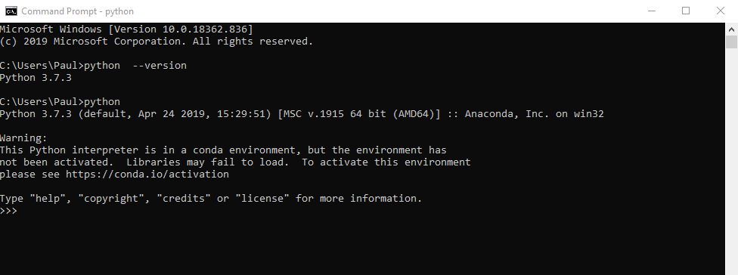
WORKING Python
Interactive mode
Before dive into programming with Python, let's explore interactive execution mode.
This Python mode offers us a command interpreter, in this case Python expressions and functions, where we can execute commands directly to the interpreter and obtain an immediate response for each one. That is to say, it is not necessary to write a complete program to start obtaining execution results, but we can "dialogue" with the interpreter of the programming language.

Slide 14
IDEs Python
For Python we have several integrated development environments, among these :
IDLE . (Windows/Linux)
Netbeans with the plugin for Python. (Windows/Linux)
Eclipse (PyDev) with the plugin for Python. (Windows/Linux)
Emacs. (Linux) Vim. (Linux)
boa constructor. (Windows/Linux)
Eric. (Linux)
Pyragua. (Windows/Linux)
Geany (Windows/Linux)
Visual Studio Code (windows/Linux)
Anaconda (Not an “IDE” it’s for scientific computing)

Slide 15
References
Python FAQ
https://docs.python.org/3/faq/general.html
Python on Wikipedia
https://es.wikipedia.org/wiki/Python
Python Tutorial, Guido Van Rossum
http://pyspanishdoc.sourceforge.net/tut/tut.html
Learn to Think Like a Programmer with Python, Allen Downey
Follow on Linkedin: Dr. Angshuman (Ph.D., MBA, BE)
Introduction to Programming in Python
Practice: https://www.hackerrank.com/
Timeline Programming Languages: https://www.youtube.com/watch?v=Og847HVwRSI

Slide 16
Thank you

